Slide 1
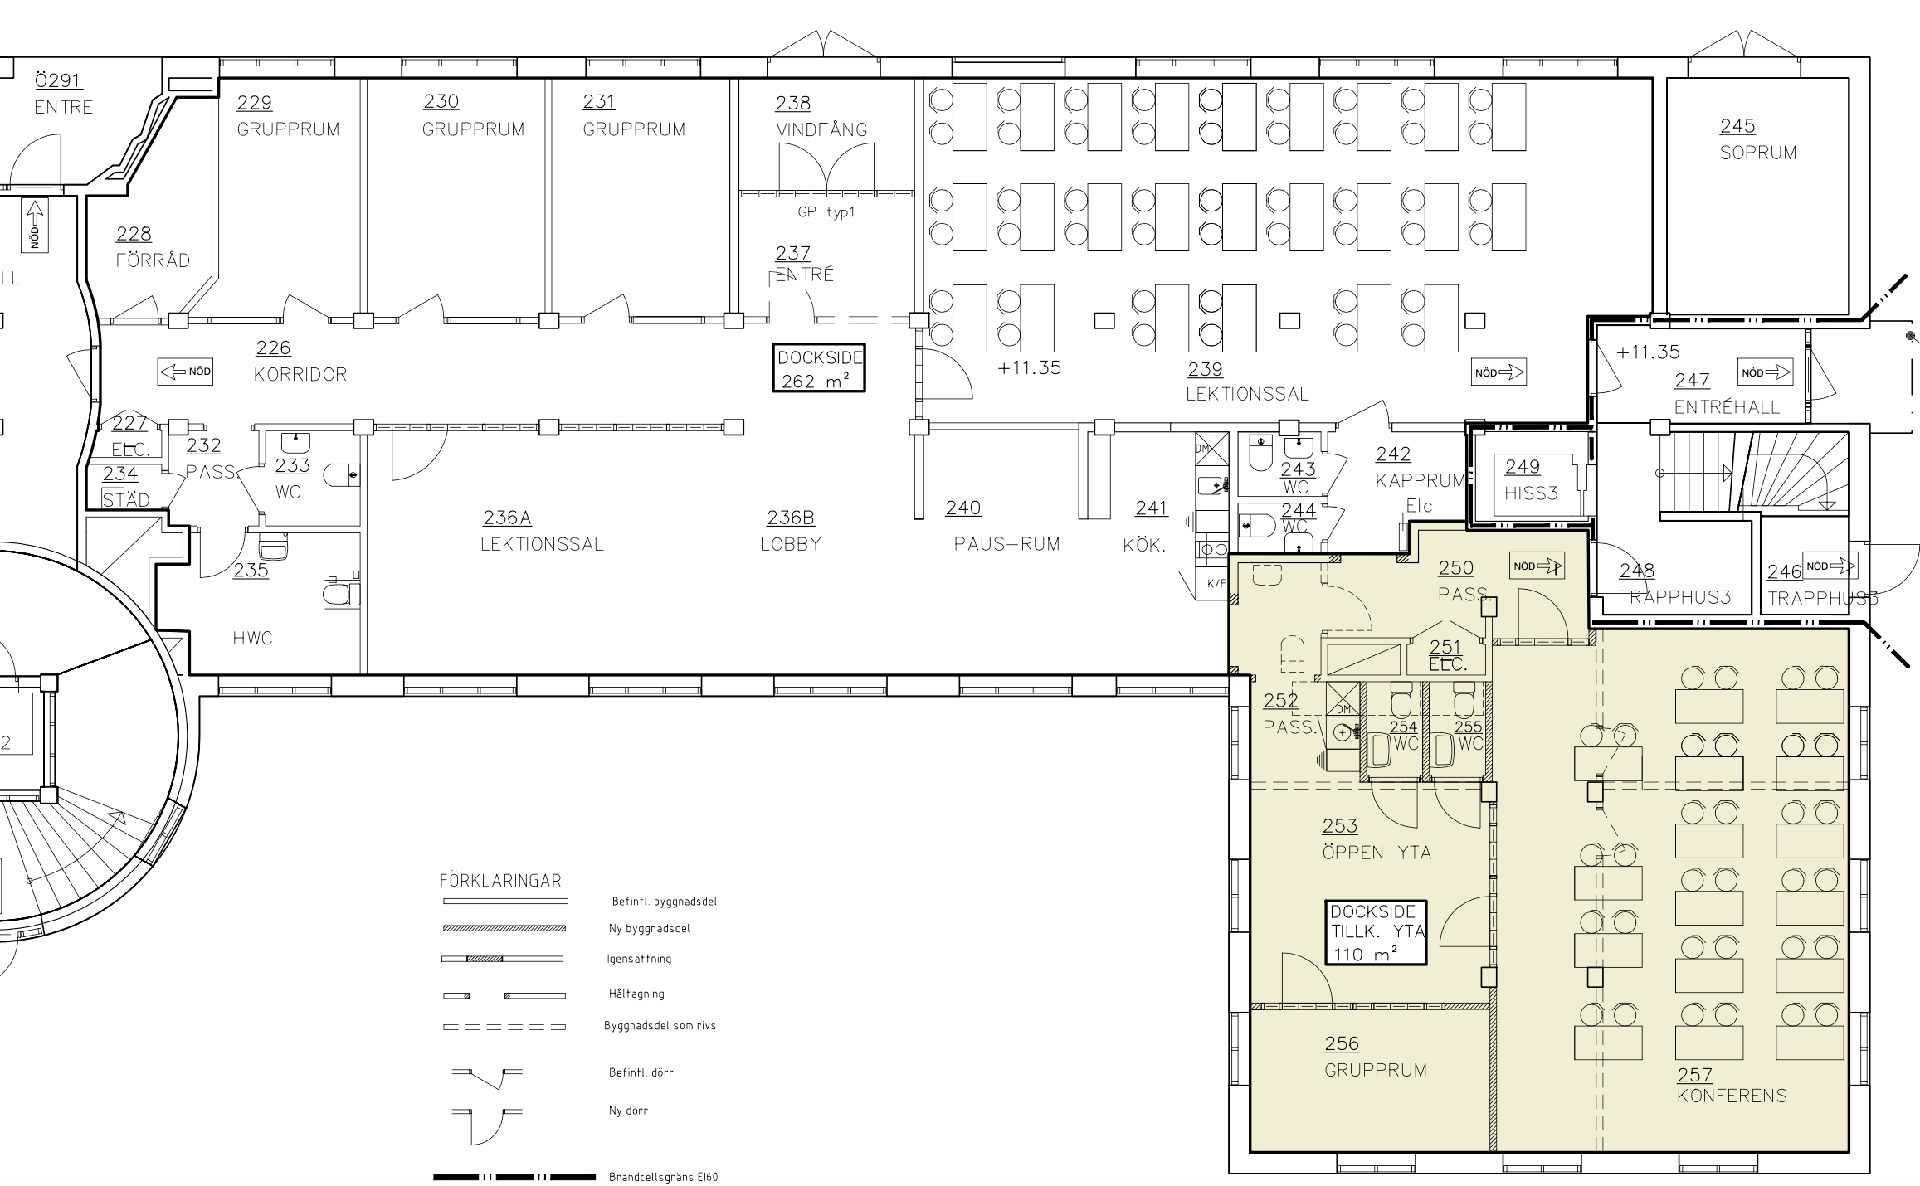

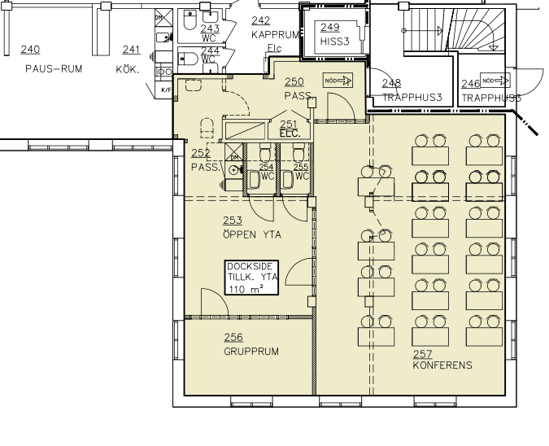


Dockside Meeting Ocra - 6 people
Dockside Meeting Rust – 6 people
Dockside Boardroom - 12 people
Dockside Conference - 24 people
Dockside Conference Large - 40 people

Slide 4
Boardroom

Slide 5
Meeting

Slide 6
Conference

Slide 7
Conference Large

Slide 8
Flex Desk – arbetsplats för dagen
Dockside Flex 1
Dockside Flex 2
Dockside Flex 3
Dockside Flex 4

Slide 9
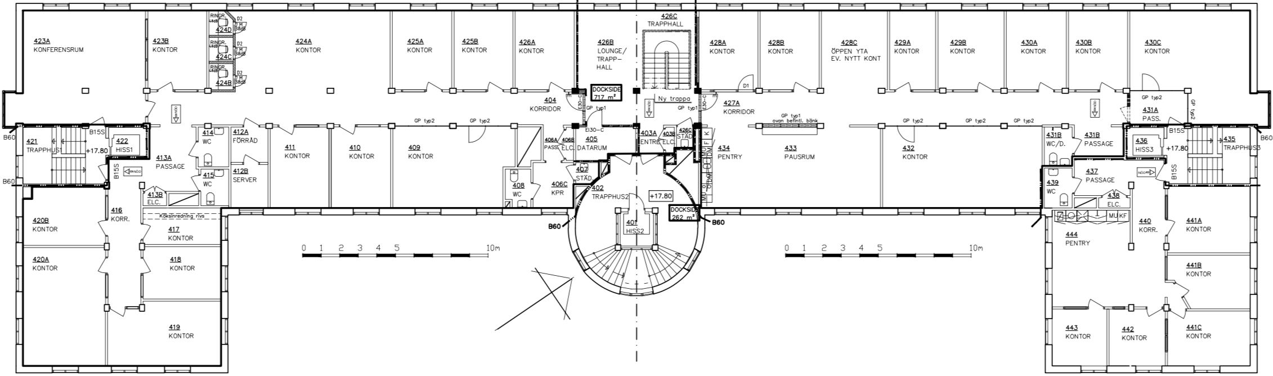
Flex Desk – arbetsplats för dagen
Plan 3
1 2
3 4
Dockside Flex 1-4

